Slide 1
Index Notation: Index Law 3 and Zero Index Law
Year 8 Mathematics
Mrs Parlevliet

Slide 2
24
7
30
Index Notation
Date
EQ – What is Index Law 3 and the Zero Index Law?
Left Hand Side: Starter Activity
1. 2² x 2³ = 2. a³ x a² =
3. 2⁴ x 2⁶ = 4. 17⁶ ÷ 17⁴ =
5. y⁶ ÷ y³ = 6. r⁹ x r³ ÷ r⁶ =
Notes:
If students don’t know where to begin, give them a clue that they need to use Order of Operations to link the numbers on the vertices to the number inside the triangle.

Slide 3

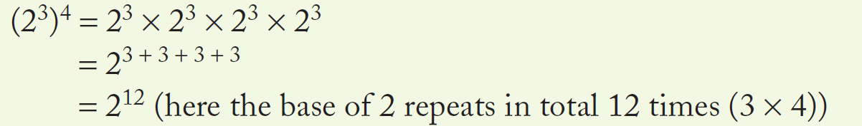
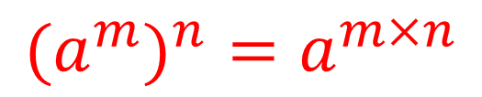
24
7
30
Index Notation
Date
EQ – What is Index Law 3 and the Zero Index Law?
Index Law 3
When a number written in index notation is raised to another power. The base remains the same and the two indices are multiplied.
How do I use Index Law 3?
$$(a^{m})^{n}=a^{m×n}$$
Example
Notes:
If students don’t know where to begin, give them a clue that they need to use Order of Operations to link the numbers on the vertices to the number inside the triangle.

Slide 4
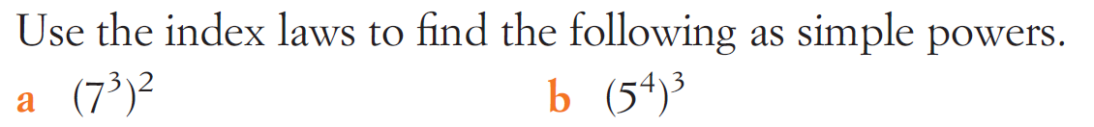

Task: We Do
$(a^{m})^{n}=a^{m×n}$

Slide 5
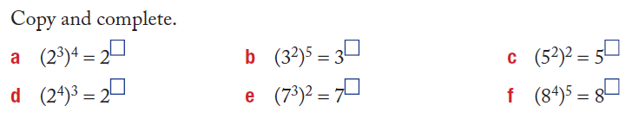
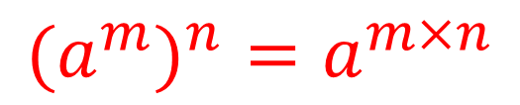
Task: You Do
$$(a^{m})^{n}=a^{m×n}$$

Slide 6


How Well Do You Understand Index Law 3?

Slide 7
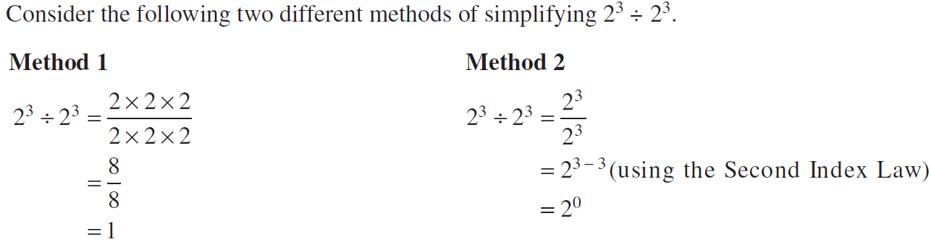

24
7
30
Index Notation
Date
EQ – What is Index Law 3 and the Zero Index Law?
Zero Index Law
Any value raised to the power of zero equals 1.
How do I use the Zero Index Law?
$$a^{0}=1$$
Example
Notes:
If students don’t know where to begin, give them a clue that they need to use Order of Operations to link the numbers on the vertices to the number inside the triangle.

Slide 8
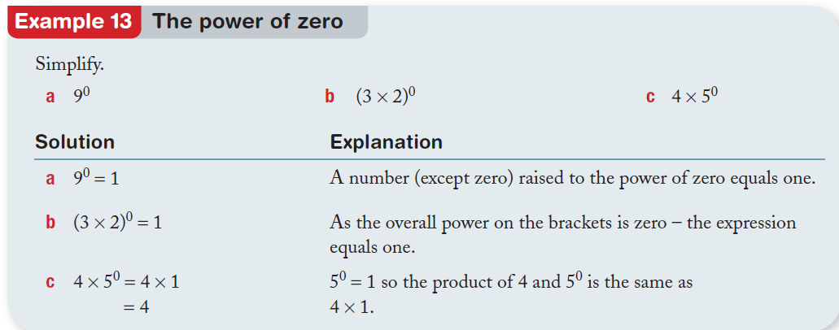
24
7
30
Index Notation
Date
EQ – What is Index Law 3 and the Zero Index Law?
How do I use the Zero Index Law?
Notes:
If students don’t know where to begin, give them a clue that they need to use Order of Operations to link the numbers on the vertices to the number inside the triangle.

Slide 9
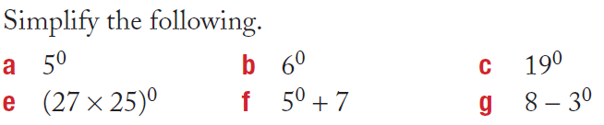

Task: You Do
$a^{0}=1$

Slide 10

How Well Do You Understand The Zero Index Law?

Slide 11
Task
Complete worksheet
Complete summary

